Slide 1

Proyecto Hipotético
Análisis de Ventas

Slide 2
Executive Summary
The objective of the document is to put on the table a hypothetical project of sales analysis. This comes in order to demonstrate the mastery of various technologies in the timely practice of data analysis and management of business information.
In order to elaborate this analysis, we need to
Bigquery (SQL): To elaborate the cleaning queries and generation of key tabs for the analysis and modeling of the information.
Tableau: To elaborate key graphs that shed light on monthly sales information, trends and product categories.
Excel: To contain the sales information to generate the data modeling.
Through this analysis we can have a better understanding of the sales information within a hypothetical context.

Slide 3
1
Methodologies Employed

Slide 4




Let's understand the methodologies with which we generate the results...
Data exploration and cleansing
Trend analysis and segmentation
Sales forecasting
Results visualization
Loading the dataset into BigQuery.
Initial scan to identify null values, inconsistencies or errors.
Use of aggregation functions and filters to verify data quality.
Ensuring that the data is reliable prior to analysis.
Evaluation of sales trends over time.
Identification of seasonal patterns and peak sales months.
Product segmentation according to profitability and sales volume.
Analysis of periods with low sales performance.
Use of BigQuery ML to train a predictive model.
Sales projection for the next months.
Comparison of predictions with historical data.
Identification of significant deviations in future sales.
Creation of a dashboard in Tableau to represent the findings.
Visualization of sales trends and best-selling products.
Incorporation of predictions into interactive graphs.
Generation of strategic recommendations based on the data.

Slide 5
2
About the analysis...

Slide 6
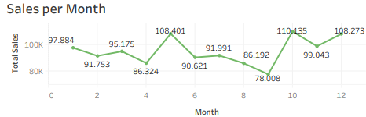
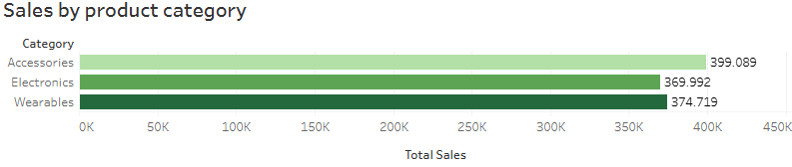
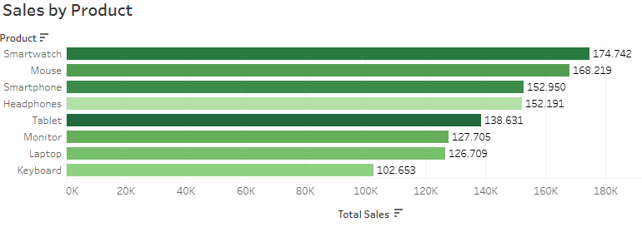
Let's look at the commercial context underlying the exercise in terms of sales over a one-year period…
Sales over time have had a fluctuating value, but with a recurring trend in the 90K.
In the months of May, October and December we have revenues greater than 100K, this may be due to holidays and vacations throughout these months.
Accessories account for the largest volume of revenue, with only a 7% difference with respect to other categories.
Electronics could improve their sales volume, although they are on par with the weareables category, with a difference of just 5K.
The products that generate the highest revenues are smartwatch, mouse, smartphone, headphones and Tablet respectively, being also the ones with the highest profit margins.

Slide 7




...For commercial purposes we understand the time segmentations in which the sales efforts were made and how to optimize the deficits.
Implement Seasonal Promotions
Launch discounts and exclusive offers during these months to incentivize purchases.
Create “Flash Sale” campaigns or special combos to attract customers.
Targeted Marketing Strategies
To determine a complete analysis of how to leverage time relative to sales efforts let's consider the following:
The months of April, August and September show significantly lower sales volume than the other periods of the year with an average of 80K.
On the other hand, the months of higher sales volume may be due to the entrance of holidays or vacation days, which would encourage a higher volume of complementary or recreational items.
Understanding these aspects in the seasonality of the year will be useful to determine those products or categories that require greater sales promotion, as well as to formulate inventory, investment and sales strategy in periods of lower purchase by customers.
Analyze consumer behavior during these months and adjust strategies.
Implement social media and email marketing campaigns with personalized promotions.
Introduce New Products or Benefits
Launch new products or improved versions to attract interest.
Offer free shipping, financing or loyalty programs to motivate purchases.
Inventory and Sales Channel Optimization
Adjust stock to avoid overstocking in these months.
Explore digital channels and alliances with marketplaces to expand the brand's presence.

Slide 8
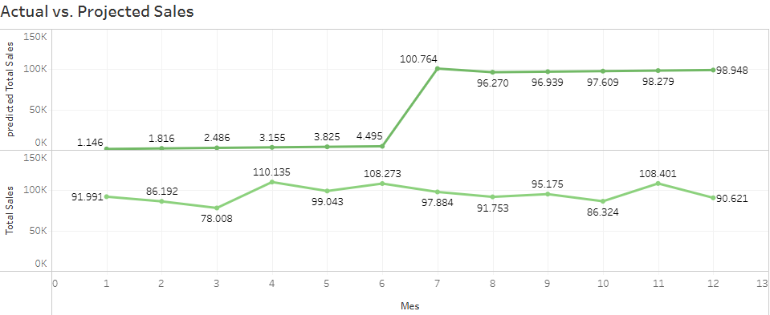
Sales forecasts and actual sales showed an overall gap of 14% between forecast and actual.
Mid-period sales forecasts had a discrepancy of 83% in the first months compared to actual sales.
For the rest of the year, the trend remained stable with average sales of $97,274.05.
Real sales averaged $87,984.58 for the entire year.
Established a difference with the forecast of $41,389.82 or in other words 53% more than what we found in the predictions.
The sales forecast analysis showed a significant discrepancy of 83% between projected sales and actual sales in the first months of the period evaluated. However, starting in the second half of the year, the trend stabilized with average sales of $97,274.05, getting closer to business reality.
Overall, actual sales averaged $87,984.58 per year, establishing a difference with the forecast of $41,389.82, which is 53% higher than estimated. This finding highlights the importance of adjusting predictive models to improve accuracy and optimize strategic inventory and sales planning in the future.

Slide 9
Conclusions and Recommendations
3

Slide 10
General recommendations of the analysis
Recommendations
Promotion strategies in key months
Boosting the electronics category
Focus on more profitable products
1
2
3
Since May, October and December generate revenues in excess of 100K, it is recommended to strengthen marketing campaigns and promotions during these months to maximize sales. In addition, anticipating demand with optimized sourcing strategies will ensure availability of key products.
Although electronics maintain a similar level of sales to the wearables category, with a difference of only 5K, it is recommended to implement specific strategies such as discounts, bundles with accessories or loyalty programs to increase their sales volume.
Given that the products with the highest revenue generation and profit margin are smartwatch, mouse, smartphone, headphones and tablet, it is key to prioritize their promotion. Upselling and cross-selling strategies linked to these products can be developed to maximize the purchase ticket.

Slide 11



Finally, let us address the general conclusions of the analysis.
Sales trend: Sales fluctuate around 90K, with three months of low demand and three months exceeding 100K due to holiday seasons.
Discrepancy in forecasts: A difference of 83% was detected between forecasts and actual sales at the beginning of the year, with an overestimate of 53%.
Annual average: Actual sales averaged $87,984.58, while the annual trend stabilized at $97,274.05.
Categories and products: Accessories generate the highest revenues, but electronics have growth potential. The most profitable products include smartwatch, mouse and smartphone.

Slide 12
4
Appendix

Slide 13
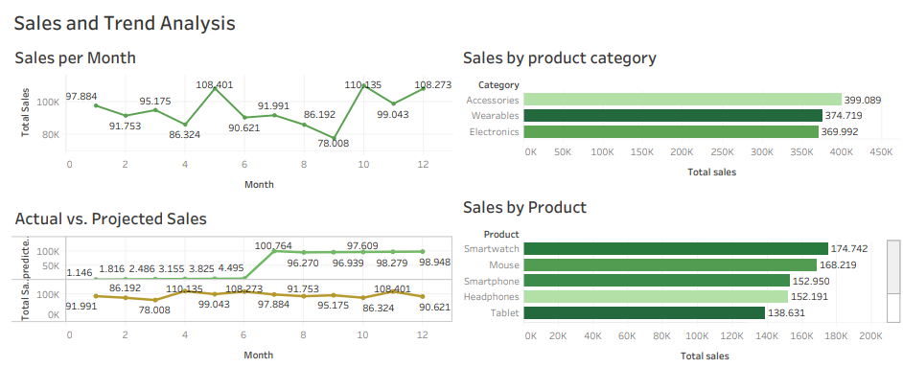
Dashboard from where the graphics

Slide 14
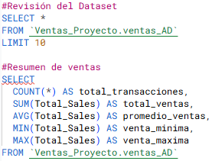
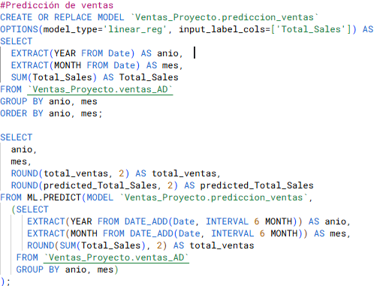
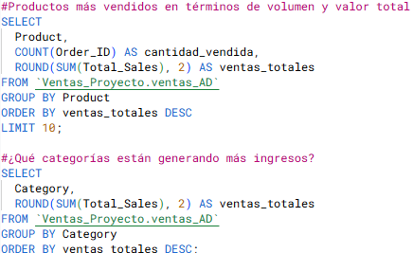
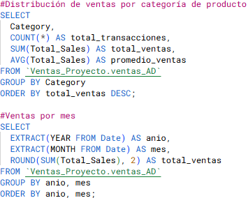
SQL guidelines for cleaning and sorting of information

